Slide 1
Annual Performance Appraisal Delivery Training
Manager Sessions – February and March 2012
Michelle Demetrius, Director Compensation and Benefits
Jerry Crawford, Manager Organizational Development, Training
Notes:
Q&A’s are captured in notes section

Slide 2
Objectives for this Session
Refresh on performance appraisal (PA) delivery schedule
Communicate PA delivery tools, processes and desired outcomes
Answer questions, listen to feedback

Slide 3
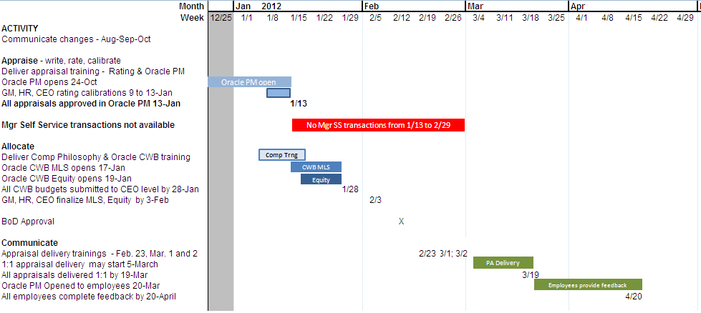
Communication Schedule
Key points
  Performance appraisals (PAs) need to be delivered one-on-one from March 5 to March 19
  Employees will have between March 20 and April 20 to go online and provide feedback
  Corporate HR will not provide merit letters this year; local HR will provide only where required by regulation
Notes:
Q&A’s
Why the push out of communication? Was Feb 20… now Mar 5. A – wanted to align beginning of delivery with earliest date when equity could be communicated which was March 5. That is our recommendation. However if you have a schedule constraint you can deliver the performance message earlier, but not the equity letter.
Why not provide merit letter? A - Part of green effort, mgr and employee self service available;

Slide 4
Appraisal process steps
Appraise
Appraiser collects performance data
Appraiser summarizes results
Appraiser writes preliminary appraisal(s)
Appraiser calibrates performance message(s)
Appraiser submits final appraisal(s) in Oracle PM
Approver dispositions final appraisal(s) in Oracle PM
Appraiser allocates merit, lump sum and equity in Oracle CWB
Appraiser calibrates and submits in Oracle CWB
Approver dispositions final allocation(s) in Oracle CWB
Appraiser delivers performance and reward message(s) 1:1
Appraisee(s) provide(s) feedback on appraisal(s)
Allocate
Communicate

Slide 5
Delivering Annual Performance Messages
Overall desired outcomes:
  Employee understands the performance message
  Manager understands employee’s point of view
  Conduct required follow-up – documentation of delivery, additional discussion as needed
Process
  Preparation
  Delivering the message
  Follow-up after the one-on-one

Slide 6
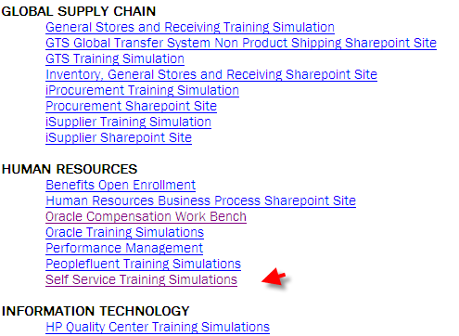
Preparation
Tools
  Training on “Delivering Performance Reviews” - http://ceburl.com/1f48 - see slides 11-12
  Performance appraisal (PA) hard copy or PDF file or Oracle PM
  Oracle Manager Self Service
  UPK training where you can find Manager Self Service training – see figure at right
Recommended process
  Review “Delivering Performance Reviews” training (above)
  Print out hard copy of appraisal (email HRIS if you need PDF copy)
    If employee cannot provide online feedback , print and sign hard copy
  Review merit changes in Oracle Manager Self Service
    Reminder: Corporate HR will not provide merit letters this year
  Obtain hard copy equity letter (if applicable)
  If applicable, complete promotion tasks
  Review the overall message
  Rehearse the delivery, anticipate questions, seek advice
  Just prior to delivery provide the employee:
    Desired outcomes and recommended process (see summary slide)
    Copy of the appraisal to pre-read
Desired outcome
  Manager and employee are prepared and ready for performance appraisal delivery session

Slide 7
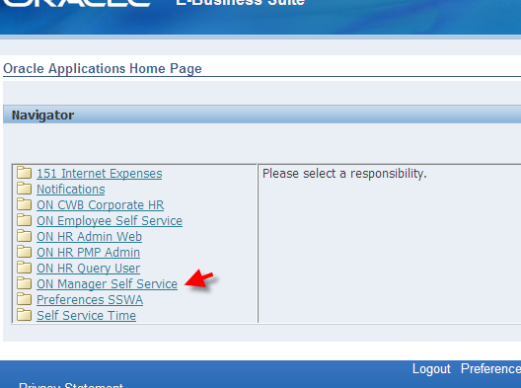
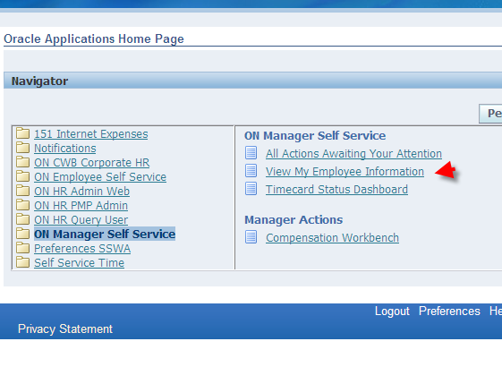
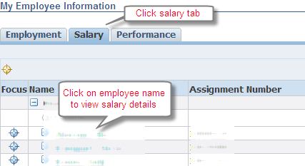
Preparation - Review Merit Changes
Log into Oracle
Click “ON Manager Self Service”
Click “View My Employee Information”
Click “Salary” tab
Click employee name to view details

Slide 8
Preparation - Obtain Equity Letter (if applicable)
Equity letters are prepared in Phoenix; they are legal documents
Local HR will be provided equity letters for their management teams
Equity letters must not be distributed before the official grant date of March 5, 2012
Equity letters must be delivered by March 16, 2012
It will be several weeks before employees get a notice from E*Trade to accept their grant
  It is important to accept the grant or it will be cancelled
  Please encourage employees to watch for notice and accept
Notes:
Q & A’s
If Mgrs is not at a location with HR, equity letters will be emailed to manager
When? Already out to local HR; most us pushing out today (Fri March 2)
Lump sum, where is that found? Have to see in CWB
Equity delivered only by post? Yes unless you are in a remote, then you will get email and you print.
Ok to email the equity letter to employee if not same physical site? Yes…
Distribution of equity letters? Equity letters coming from Phx
Window for acceptance is up to first vest date…. Usually one year after grant…some have lost their grant….
It is in CWB…
If can’t physically give them? Email them. If possible
Employees in PH… in the past said it was not correct…based on salary….

Slide 9
Preparation - Promotion Tasks (if applicable)
Tools
  Processes and Forms under Human Resources > Total Rewards > Career Development
  Oracle Manager Self Service
  UPK training for Manager Self Service
Process
  Choose appropriate form and process
  Complete justification
  Obtain preliminary approval
  Use Oracle Manager Self Service to enter pay grade and salary change; attach justification documentation
Desired outcomes
  Promotion justification completed
  Promotion decision completed and documented
Notes:
Q&As
Once promotion is submitted is there someplace in Oracle I can track progress? A - No other than you will received notifications as it is approved at each step… confirmed with HRIS…
360 required for non-exempts? Different processes used … typically no

Slide 10
Preparation - Overall Message
What is the overall performance message?
  Key point(s) you want them to remember
How does merit support and reinforce the message?
How does equity support and reinforce the message?

Slide 11
Rehearsal – Accomplishments, Performance
Do…
  Schedule enough time
  Link accomplishments to impact on business
  Recognize, appreciate strengths
  Be descriptive when giving examples
  Encourage employee input
Common pitfalls
  Not allocate enough time
  Over-focus on development
  Make generalizations
  Use jargon
  Make value judgments

Slide 12
Rehearsal – Improvement Areas, Ratings
Do…
  Frame problems as development opportunities
  Respond calmly to negative reactions
  Own the feedback
  Emphasize words of encouragement
  Ensure employee understands terms
  Encourage employee input
  Explain expectations (observable behavior/results) associated with different ratings
  Explain pay and performance decision processes
Common pitfalls
  Use overly negative language
  Avoid difficult questions
  Become defensive or apologetic
  Express dissatisfaction with appraisal system or decisions
  Discuss other employees’ ratings
  Use jargon
  Make promises

Slide 13
Rehearsal - Communicating Merit and Equity
Remember, the compensation budget percentage for a country is not the same as the average merit increase; it was the total budget for the year – including promotions, merit and other salary changes.
Review factors that went into your merit allocation
  Rating
  Position in pay range
  Promotion
  Performance message
  Internal equity
  Available budget
Review factors that went into your equity allocation
  Eligibility
  Country/grade targets
  Rating
  Performance message

Slide 14
Just Prior to Delivery – Share with Employee…
Desired outcomes for the delivery session
Guidelines you’ve been given as an appraiser
  May use summary slide or other excerpts from this package
A copy of the appraisal (optional)

Slide 15
Appraisal Delivery One-on-One
Tools
  Appraisal print out, PDF file or Oracle PM
  For paper process – prepare and sign hard copy
  Oracle Manager Self Service
  Face-to-face or phone call
  Find a quiet, private location to minimize interruptions
Process
  Re-state desired outcomes
  Follow the guidelines - use effective language, encourage employee input, communicate differentiation
  Paper process – Employee signs hard copy appraisal indicating they have read and understand; may add written feedback
  Agree on any follow-up required after the meeting - online feedback, accepting equity grant, additional performance/goal discussions
Desired outcomes
  Mutual understanding of performance message
    Employee does not have to agree with evaluation
  Employee understands and has the tools to close the process
    Note: If they cannot provide feedback online appraiser will need to do a hard copy process

Slide 16
Follow-up After the One-on-One
Tools
  Oracle PM – Employee Self Service
  UPK training on how to provide feedback online or
  Paper process – signed hard copy
Process
  Online – employee logs into Oracle PM > ON Employee Self Service > Notifications or Performance Management link > Provide feedback
  Paper process – Appraiser routes signed original to HR for retention in employee records
  Follow-up meetings – if desired, either participant may request third party (suggest HR representative) attend
  If the employee received equity, employee needs to accept when E*Trade notice is received
Desired outcomes
  Confirm employee has read appraisal (view online or signed hard copy)
  Process is closed by April 20
  Any next steps are agreed upon by manager and employee

Slide 17
Escalation
Expect manager and employee to successfully resolve any differences in most cases
If manager and employee cannot resolve, then recommend escalate to second level manager
If second level manager cannot resolve, escalate to HR
HR will investigate and make a decision
HR decision is final

Slide 18
Summary
Performance appraisals (PAs) need to be delivered one-on-one from March 5 to March 19
Employees will be able to go online and provide feedback beginning March 20
  They have until April 20 to provide feedback online
  After that their appraisals will be administratively approved
Manager actions to ensure a successful PA delivery
  Preparation
  Deliver using effective language, encourage employee input, communicate differentiation
  Follow-up to complete the process
If you have any questions you may contact your manager, your local HR representative, Jerry Crawford or Michelle Demetrius
Notes:
Q&A’s
Processing promotions – when can we start? A - Manager Self Service Change action menu items will be available no later than March 1; we hope to open it up sooner; you can start completing forms, talking to the decision makers now.
Effective date? Depends on your payroll; generally effective date is July 16; you may actually see the increase later, depending on your payroll schedule
Mandatory feedback required? If employee refuses, document in your notes or note on hard copy of appraisal…
Will it be exactly what is in CWB approved? Yes, but appearance may vary slightly – will see slightrounding off of amounts in Japan and one other country

Slide 19
Reference

Slide 20
Allocating merit, lump sum - budget
The percentage established for the country is NOT a target merit percent. This is the overall percentage budget for both merit and other salary changes for the year.
  This budget is set based on multiple surveys (Radford, Tower Watson, Hewitt, World at Work, Mercer, EAC and other local surveys)
  This budget may be adjusted based on other considerations in a country such as acquisition adjustments, pending closures, other significant variable or fixed pay, etc.
  Note: Employees in Belgium all receive an annual Cost of Living Allowance increase
This is typically the most misunderstood concept when communicating merit to employees.
  The manager communicates the percentage budget for the country as the target and sets the employee’s expectation that they should be at least that percent or higher. This sets an incorrect expectation.
    Good employees may receive less than the “country budget” because some of the budget is meant for the department to use for promotions and other salary adjustment based on items which we will discuss next.
Notes:
Comments –
Remember …..

Slide 21
Allocating merit, lump sum - rating
HR does not issue a matrix forcing a particular allocation.
However, senior executives or your direct manager may set particular guidelines for their teams for allocation of merit.
First, of course, you should consider the performance rating of the employee
  Typically IDL employees who are “Top Performers” (rating 1-2-3 on scale of 9) should receive a higher merit. You may also want to consider your high potential “Good Performers” (rating 4).
  Typically DL employees with a rating of 4 and 5 should receive a higher merit.
  Typically employees rated 8-9 on a scale of 9 and employees rated 1 on a scale of 1-5 should not receive a merit increase.

Slide 22
Allocating merit, lump sum – pay range
Employee’s position in the pay range
  Typically, employees higher in the pay range are being paid above market. If these employees are your critical talent, HIPO’s and high performers, then this is reflecting a proper allocation of base pay.
  If these are your good employees, then you might consider a slightly lower merit to allow you flexibility to recognize your critical talent, HIPO’s and high performers more effectively with a higher raise or cash award.
    A lump sum is also a good alternative.
  Employees that are new to their position who are rated a 7 on the scale of 1-9 or a 2 on the scale of 1-5, are currently paid in excess of their contribution to the organization. So a smaller merit would be appropriate.
    A lump sum is also a good alternative.
  While not required, we HIGHLY recommend use of a lump sum for employees over the maximum of the range.
  There is only one salary range per country.
    If the employees are in a lower cost region of the country, being below midpoint is not unusual.
    If they are in a higher cost region, more of the group may be above the midpoint.

Slide 23
Allocating merit, lump sum - promotions
Employee promotions, either recent or planned
  Remember, your budget is for all types of salary increases, not just merit.
  If an employee recently received a promotion, we would expect to see them rated a 5, 6 or 7, and potentially receive a slightly lower merit.
  Because Manager Self Service is now used to request promotions for employees, Compensation Workbench (CWB) will no longer support the entry of Promotions.
    If you are planning a promotion, then you may want to not put a merit increase in CWB for this employee.
    However, do not spend all the budget money on other employees, as you will still need the money for the promotion.
    If you put a merit increase into CWB, then the Manager Self Service will not allow a promotion/salary change for the employee until an effective date of July 17th or later.

Slide 24
Allocating merit, lump sum - message
Finally, and most importantly, you need to consider the overall message you are trying to send to the employee.
  Again, the budget percent for the country is not the target merit percent and you should explain that.
  Common Pitfalls in merit/performance discussions:
    Merit increases are relative to performance, but stay on task discussing the employee’s performance. Do not get sidetracked into justifying the way you rated another employee in comparison.
    Good sentences to use in this situation:
      “Your merit is based on performance, position in the grade and available budget.”
      “It would be inappropriate for me to discuss your co-worker’s performance or merit with you as this is confidential information. I can assure you, I made equitable and fair merit increase decisions within the allowed budget and parameters.”
    Do not make promises for future compensation based on performance changes or potential for advancement. If you are unable to deliver due to financial conditions or employee perception of performance changes, you may lose credibility for future discussion.
  If your employee is not performing well, make sure the merit also communicates that message.
  Do not give an average merit to everyone just because of the belief that will make the communication easier. It does not, as it demotivates your high performers and over-rewards low performers.

Slide 25
Allocating merit, lump sum – internal equity
The considerations discussed in the preceding slides, should help adjust the internal equity of your team over time.
  Lump sums can be used at any position in the range to help with internal equity.
  But caution is urged in over-using lump sums for employees in the lower portion of the range so they do not fall behind market and are targeted by competitors.

Slide 26
Factors for allocating equity
Employee eligibility
  Only IDL, salaried employees in grades 7+ are eligible.
  Not all countries are eligible for equity
Consider the performance rating of the employee
  Typically IDL employees rated 1 to 4 on a scale of 9 should receive a higher equity grant. These include your “Top Performers” (rating 1-2-3) and high potential “Good Performers” (rating 4)
  If you have additional equity available, you could then consider your employees rated 5 to 7.
    Remember that your new hires and recently promoted employees may have just received a grant with their new job.
Remember to make the equity grant a meaningful size
  For example, if the equity vests 1/3 per year, so an equity grant of 100 units would only vest 33 units a year, which is not very meaningful and would probably not retain an employee.
Consider the overall message you are trying to send to the employee
  Equity, because there is a limited amount available to grant, should really be limited to higher performers.
  If you give a small amount to all your employees, you are sending a message that they are all your top performers and there is no distinction amongst your staff.
  Giving to all also leads to an entitlement mentality – they just have to put in another year to get more equity, which is not true. You should not plan on giving equity to the same employees each year.
  Giving small amounts to all is less meaningful and does not lead to appropriately targeted retention/motivation.
  Consider if you already gave the employee an equity or cash award recently.

Slide 27
Nine-box Rating Descriptions
1
TP2
2
TP1
3
TP
Consistently exceeds expectations
In top 20% of your performers
Consistently exceeds goals, budget, schedule
Realistic chance employee could advance two grade levels in 2-3 years
Consistently exceeds expectations
In top 20% of your performers
Consistently exceeds goals, budget, schedule
Realistic chance employee could advance one grade level in 2-3 years
Consistently exceeds expectations
In top 20% of your performers
Consistently exceeds goals, budget, schedule
Likely employee will stay at current grade level over next 2-3 years
4
GP2
5
GP1
6
GP
Meets, sometimes exceeds expectations
Meets, sometimes exceeds goals, budget, schedule
Realistic chance employee could advance two grade levels in 2-3 years
Meets, sometimes exceeds expectations
Meets, sometimes exceeds goals, budget, schedule
Realistic chance employee could advance one grade level in 2-3 years
Meets, sometimes exceeds expectations
Meets, sometimes exceeds goals, budget, schedule
Likely employee will stay at current grade level over next 2-3 years
Performance
7
BE2
8
BE1
9
BE
In bottom 20% of your performers
New to role (box 7)
Does not always meet goals, budget, schedule
Realistic chance employee could advance two grade levels in 2-3 years
In bottom 20% of your performers
Does not always meet goals, budget, schedule
Realistic chance employee could advance one grade level in 2-3 years
In bottom 20% of your performers
Does not always meet goals, budget, schedule
Likely employee will stay at current grade level over next 2-3 years
Advancement Potential within 2-3 years

Slide 28
Nine-box Rating Phrases, Abbreviations
high
1
Total = 0-20%
Total = 0-100%
Total = 0-20%
Top Performer,
Two levels up potential
(TP2)
(0-3%)
2
Top Performer,
One level up potential
(TP1)
(0-10%)
3
Top Performer
(TP)
(0-20%)
Distribution
Requirements
Top Performer
Total = 0-20%
4
Good Performer,
Two levels up potential
(GP2)
(0-10%)
5
Good Performer,
One level up potential
(GP1)
(0-100%)
Good Performer
(GP)
(0-20%)
6
Good Performer
Performance
Total = 60-100%
7
Below Expectations,
Two levels up potential
(BE2)
(0-20%)
Below Expectations,
One level up potential
(BE1)
(0-20%)
8
Below Expectations
(BE)
(0-5%)
9
Below
Expectations
Total = 0-20%
low
high
Two or more grade levels
One grade level
Steady at current grade
low
Advancement Potential within 2-3 years

Slide 29
Below Expectations Guidelines
high
1
TP2
2
TP1
3
TP
4
GP2
5
GP1
GP
6
Performance
7
BE2
BE1
8
BE
9
Redirect
low
high
Advancement potential within 2-3 years
low
Box 7 is for employees new to role; limited to one year or less in box 7
Box 8 employees require a focused effort by manager and employee
  Do not require Performance Improvement Plan (PIP)
  If performance doesn’t improve employee rating goes to box 9
Box 9 employees have two choices
  Go on a (PIP) or
  Discuss separation option with their manager
Overall, employees are limited to two consecutive years in “Below Expectations” row
Notes:
The following is an example of negligent management that is not acceptable…
Mgr goes to HR or senior management and say I need to “get rid of” someone….
And that person has never received a low performance message before…

Slide 30
Performance Rating 1-5 Definitions for DL

